Slide 1

JSX and the Virtual DOM
Lesson 02
Notes:
Add instructor notes here.

Slide 2
Lesson Objectives
At the end of this module you will
be able to:
Explain the importance of React.js
Virtual DOM
Working of Virtual Dom
JSX
React Element
Render()
JSX attribute expression
JSX Conditional Child Expressions
Notes:
Add instructor notes here.

Slide 3

Virtual DOM
"React abstract away the DOM from you, giving a simpler programming model and better performance"
- React
In React, for every DOM object, there is a corresponding "virtual DOM object.
A virtual DOM object is a representation of a DOM object, like a lightweight copy.
- CodeAcademy
Notes:
DOM manipulation is the heart of the modern, interactive web. Unfortunately, it is also a lot slower than most JavaScript operations.
To address this problem, the people at React popularized something called the virtual DOM.
A virtual DOM object has the same properties as a real DOM object, but it lacks the real thing's power to directly change what's on the screen.
Manipulating the DOM is slow. Manipulating the virtual DOM is much faster, because nothing gets drawn onscreen.
In summary, here's what happens when you try to update the DOM in React:
The entire virtual DOM gets updated.
The virtual DOM gets compared to what it looked like before you updated it. React figures out which objects have changed.
The changed objects, and the changed objects only, get updated on the real DOM.
Changes on the real DOM cause the screen to change.
- codeAcademy
Slide explains that communication between service provider and consumer happen via SOAP messages

Slide 4
Virtual DOM
A DOM(Document Object Model) represents web page in a tree structure. It also refers how these page elements are accessed and changed
Updating the DOM is expensive
Reading and writing to DOM using DOM API are slow because they are not optimized for speed
JavaScript Objects are faster than DOM Objects
React offers the Virtual DOM which is a pure JavaScript intermediate representation of DOM
React never reads from the real DOM. It only writes to real DOM if needed, so it efficiently handles DOM Updates
The process of updating only part of the DOM structure is called as "reconciliation"
Notes:
These are the components of Web services.
WSDL defines how incoming information, such as queries, need to be structured for the service application to make sense of it, and how outgoing data will be structured so that the requesting application can understand it.
These definitions are stored as XML (Extensible Markup Language) specifications
A common structure for WSDL information is the Simple Object Access Protocol (SOAP) that allows communication between applications
A UDDI is a directory structure to locate the web service
The slide explains in brief, the components which make up the web service

Slide 5
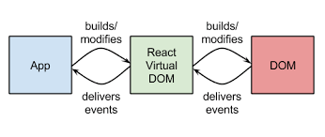
React and Virtual DOM
React offers the Virtual DOM which is a pure JavaScript intermediate representation of DOM
React never reads from the real DOM. It only writes to real DOM if needed, so it efficiently handles DOM Updates
The process of updating only part of the DOM structure is called as "reconciliation"
Notes:
Slide explains about WSDL and UDDI registry.
Also explains regarding web service communication

Slide 6
How Virtual DOM Works?
Whenever the data model state changed, the virtual DOM and React will re-render the UI to a virtual DOM representation
React calculates the difference between the two virtual DOM representations: the previous virtual DOM representation that was computed before the data was changed and the current virtual DOM representation that was computed after the data was changed. This difference between the two virtual DOM representations is what actually needs to be changed in the real DOM
React updates only what needs to be updated in the real DOM
DOM
React Virtual DOM
JS Logic
Notes:
Add instructor notes here.

Slide 7
React: How React Renders the View?
JSX Code written describing the basic application
JSX is converted into JavaScript by the compiler
React turns converted JSX into a Virtual DOM
Virtual DOM is applied to Real DOM
Underlying Data Model is updated
React Updates Virtual DOM and then updates the real DOM in efficient Manner
Notes:
Add instructor notes here.

Slide 8
JSX (JavaScript and XML)
is JavaScript syntax extension which looks similar to XML
looks like HTML but is actually a mix of JavaScript and HTML.
It's easier & faster to write JSX, compared to JavaScript.
JSX code ensures readability & Maintainability.
JSX finds most of the errors at compilation time, which makes it faster
Comparitively to javascript.
Babel would transform the above JSX code to the required react function as shown:
var grp = <div>
<p>Welcome to TutsPlus</p>
</div>;
var grp = React.createElement( "div", null, React.createElement(
"p", null, "Welcome to TutsPlus" ) );w
Notes:
Babel is nothing but Transpiler,
Babel can convert JSX syntax and strip out type annotations.

Slide 9
React Element
A React element describes what you want to see on the screen.
A React element is an object representation of a DOM node.
JavaScript objects are lightweight
So React can create and destroy these elements without too much overhead.
React is easily analyzes the object, for changes in previous Object with current, and then updates the actual DOM only where those changes occurred.
JSX produces React "elements“. A similar given below code snippet can be created using a method ‘createElement()’, which we will see in the later slides.
Output of above code will render –
And when it’s rendered to the DOM will be like
const element = React.createElement( 'div', {id: 'login-btn'}, 'Login' );)
{ type: 'div', props: { children: 'Login', id: 'login-btn' } }
<div id='login-btn'>Login</div>

Slide 10
ReactDOM.render
Render a ReactElement into the DOM in the supplied container and return a reference to the component.
If the ReactElement was previously rendered into container, this will perform an update on it and only mutate the DOM as necessary to reflect the latest React component.
If the optional callback is provided, it will be executed after the component is rendered or updated
ReactDOM.render( element, container [, callback ] );
ReactDOM.render(<h1>Hello, world</h1>
, document.getElementById('root'));

Slide 11
React.createElement
The createElement method will generate a new ReactElemen.
It is created using at least one, and optionally up to three, arguments to the function a string type, optionally an object props(attributes), and optionally children (text / element)
React.createElement( type, [props[, [children ...] );
React.createElement( 'h1', {className: 'greeting'},
'Hello, world!' );

Slide 12
Demo
React-create-element-demo
* includes render, JSX
Notes:
Add the notes here.
Add instructor notes here.

Slide 13
JSX Attributes Expressions
Expressions in React is embedding any Javascript expression is by wrapping it in curly braces.
for example : {20/4}, format (user),users.name
After compilation, JSX expressions become regular JavaScript function calls and evaluate to JavaScript objects.
const element = <img src={user.avatarUrl}></img>;
Don’t put quotes around curly braces when embedding a JavaScript expression in an attribute.
You should either use quotes (for string values) or curly braces (for expressions), but not both in the same attribute.
Notes:
Note :
Since JSX is closer to JavaScript than to HTML, React DOM uses camelCase property naming convention instead of HTML attribute names.
For example, class becomes className in JSX, and tabindex becomes tabIndex.
CHECK FOR SPREAD ATTRIBUTES

Slide 14
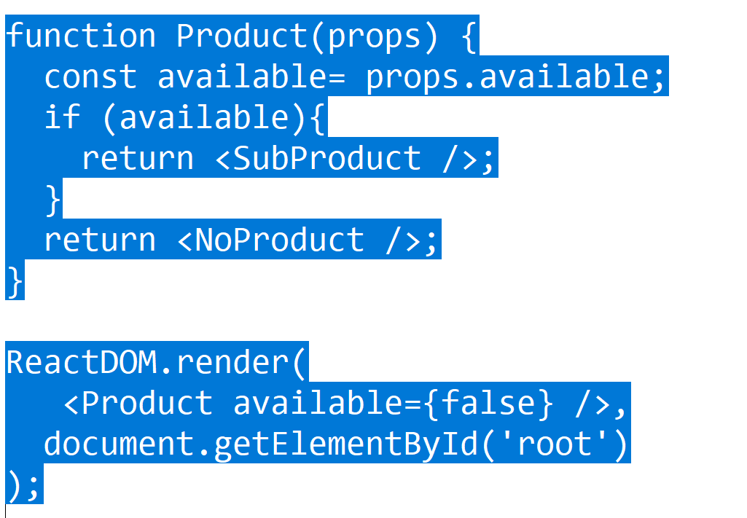
JSX Conditional Child Expressions
Conditional rendering in React works the same way conditions work in JavaScript. Use JavaScript operators like if or the conditional operator to create elements representing the current state, and let React update the UI to match them.

Slide 15
Demo
react-create-attr-conditional-render
* includes conditional rendering + jsx attributes
demo
Notes:
Add the notes here.
Add instructor notes here.

Slide 16
Summary
Explain the importance of React.js
Virtual DOM
Working of Virtual Dom
JSX
React Element
Render()
JSX attribute expression
JSX Conditional Child Expressions
Notes:
Add the notes here.
Add instructor notes here.

Slide 17
Summary
Explain the importance of React.js
Virtual DOM
Working of Virtual Dom
JSX
React Element
Render()
JSX attribute expression
JSX Conditional Child Expressions

Slide 18
review
1. JSX is a shorthand for
A) Javasctipt & XML
B) XML and java
C) Javascript & Java
D) HTML & Javascript
2. To Enable a browser to read JSX, first, we need to transform JSX file into a JavaScript object using JSX transformers like?
A) Babel
B) Babel Transformer
C) Gulp
D) React Compiler
3. Which of the following is correct option to display a image using jsx attribute expression
A) const element = <img src={user.avatarUrl}></img>;
B) const element = <img src=avatarUrl></img>;
C) const element = <img alt={user.avatarUrl}></img>;
D) const element = <img alt=user.avatarUrl></img>;

